Slide 1

Stock Research Application Project Progress Report #2
Group 5

Slide 2

Agenda
System Overview
Structural Views
Quality Views
Combined Views
Conclusions and Next Steps

Slide 3

System Responsibilities and Capabilities
The system supports five major capability domains:
User Management: Securely authentication, personal data storage, and portfolio ownership.
Analytical Insights: Technical indicator computation and stock trend evaluation.
Market Intelligence: Aggregation of financial articles, social feeds, and sentiment scoring.
Portfolio Tracking: Performance dashboards, position summaries, and profit/loss calculations.
Real-Time Monitoring: Automated alerts triggered by stock movements and thresholds.

Slide 4
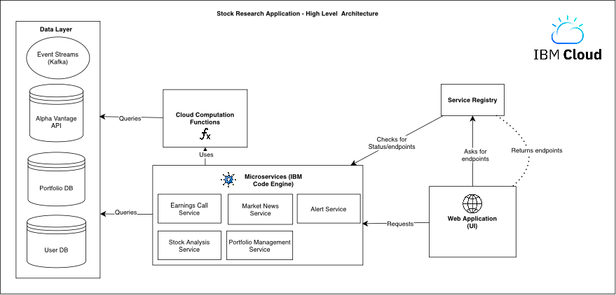

Slide 5

Module View - Layered
Four-Layer Architecture
Application Pages Layer
User-facing interface that collects inputs and renders results.
Application Services Layer
Backend orchestration, authentication, and workflow coordination.
Domain / Analytics Layer
Computational logic including indicators, sentiment scoring, ranking, and portfolio metrics.
Data Management Layer
Persistent storage and external data integrations (databases, APIs, event streams).

Slide 6
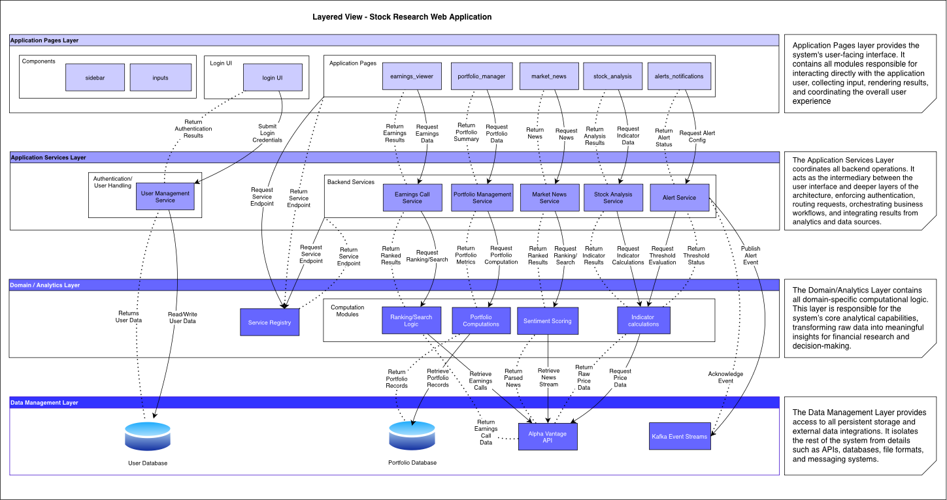

Slide 7
Rationale and
Benefits​
Why a Layered Architecture?
Modifiability: UI, services, analytics, and data can evolve independently.
Separation of concerns: Each layer handles a distinct responsibility.
Reusability: Analytics logic is shared across multiple services.
Scalability: Services and data sources scale without UI changes.
Maintainability: Clear module boundaries simplify debugging and extensions.
Dependency Rules
Allowed
Pages → Services
Services → Analytics
Analytics → Data
Data → returns only (dashed)
Not Allowed
UI accessing data directly
Analytics calling UI or services
Cross-layer circular dependencies

Slide 8

Component and Connector View
Key Benefits:
Loose coupling: Components interact only through well-defined connectors
Scalability: Each service auto-scales independently in Code Engine
Modifiability: Computation modules and microservices can evolve without UI changes
Resilience: Service registry enables dynamic lookup of healthy instances
Separation of concerns: UI, services, analytics, and data layers are isolated

Slide 9
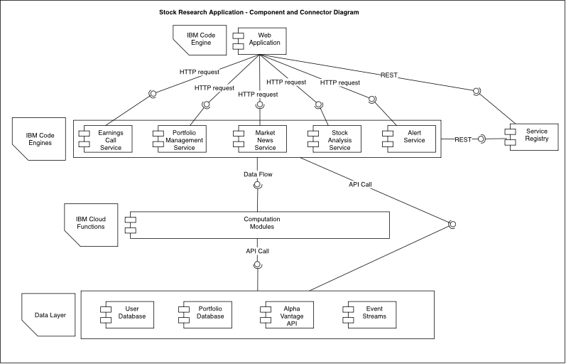
Component and Connector View

Slide 10
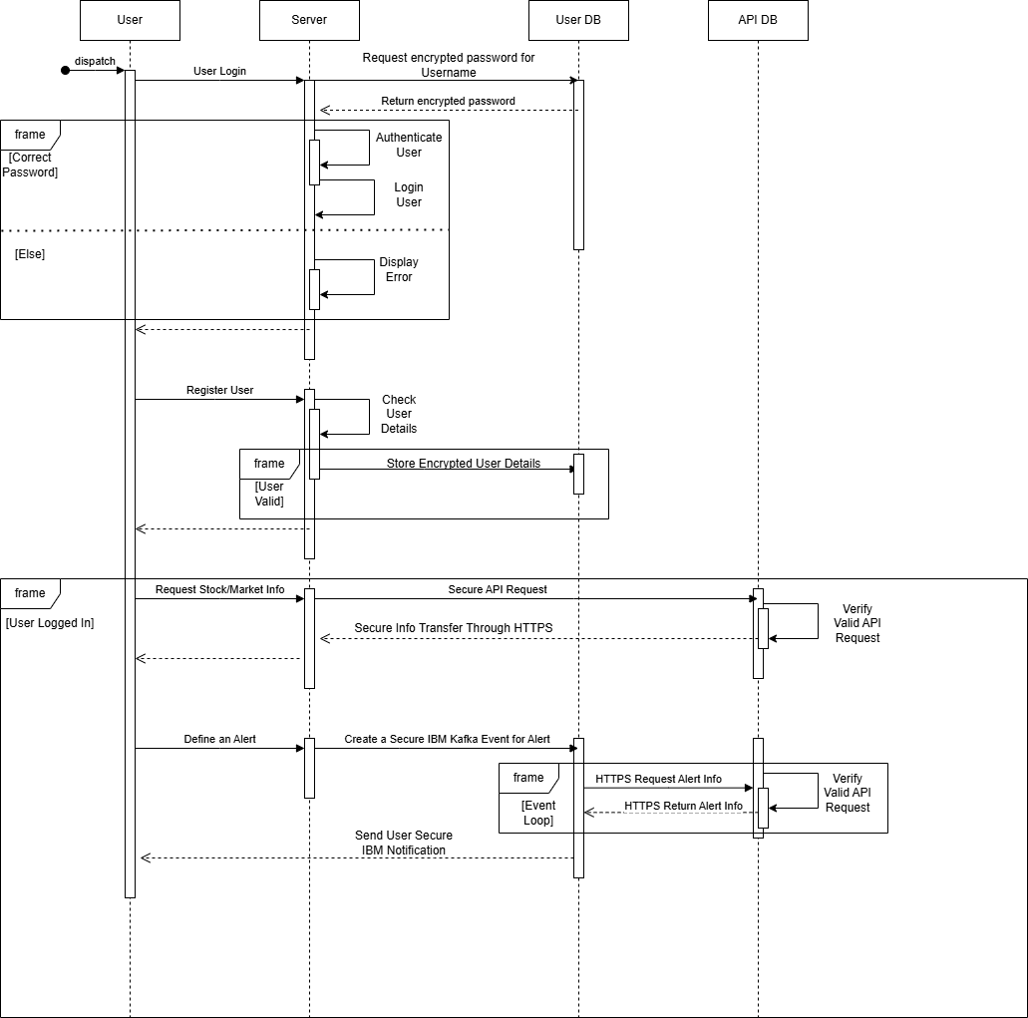

Quality Views - Security

Slide 11

Security View
Purpose
The purpose of the security view is to show how security interacts with the system and where it is present. In the sequence diagram we have identified all components that use some sort of security and show the links between these components.
Our requirements for security are keeping user data and data transfers secure.

Slide 12


Security View
Security Implementation
These are the forms of security present in our system and shown in the sequence diagram:
Validating passwords, user details, and API keys are all part of ensuring that data received is safe and applicable to the system.
Secure Transfer Protocols:
  HTTPS is a common protocol used to transfer information, but it is also known to be a safe transport protocol (The S at the end of HTTPS stands for Secure). Requests and returns to and from the API database all use HTTPS.
  IBM Security Protocols: Our server, database, and many of our other services are all hosted on IBM cloud. They all use IBM security protocols for the safe transfer of data to and from these locations.

Slide 13
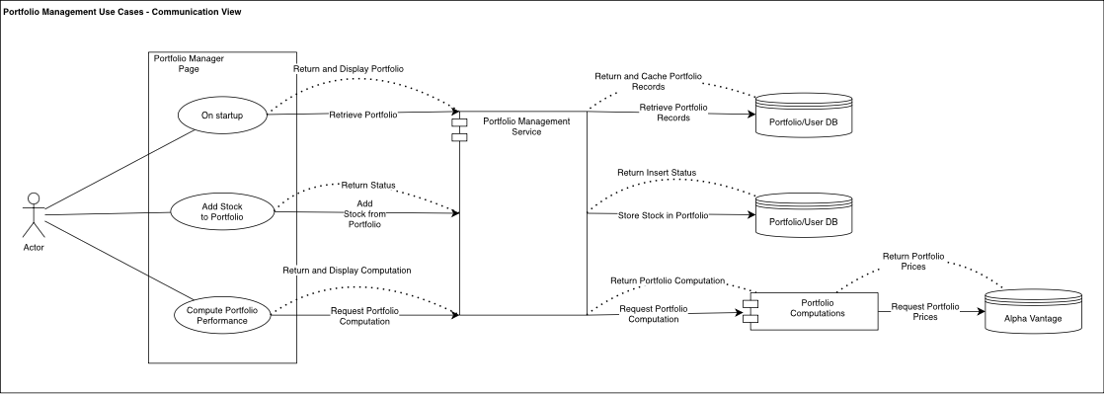
Quality Views - Communication

Slide 14
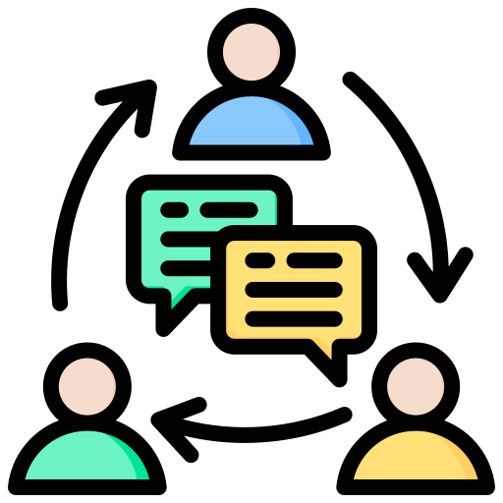
Communication View
Purpose
Interaction across multiple microservices and external systems.
  Loose coupling between services
  Dynamic scaling and replacement of microservices
  Clear separation of responsibilities

Slide 15
Communication View
Implementation of communication
Clear separation of communication responsibilities is enforced in the architecture.
  Microservice Isolation
Dynamic Replaceability
  any microservice can be removed, updated, or redeployed without affecting others.
Portfolio Management Service (Gateway Layer):
  Acts as the single point of communication for the UI.
  reducing communication complexity

Slide 16
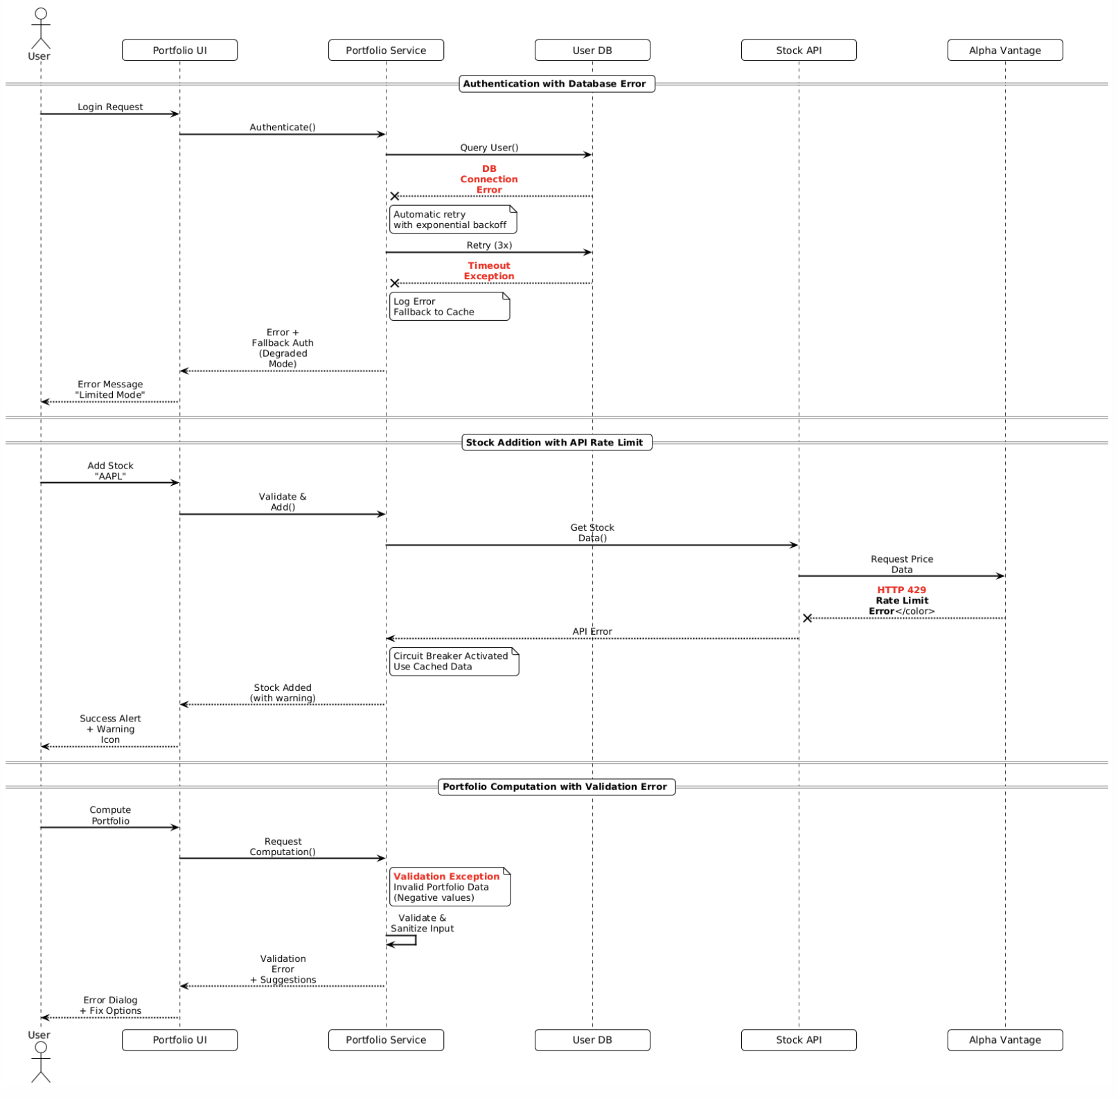
Quality View – Error/Exception Handling

Slide 17

Error/Exception-Handling View
Purpose
• Ensure System Resilience: Maintain service availability during component failures and network issues
• Prevent Cascade Failures: Isolate faults to prevent system-wide outages
• Preserve Data Integrity: Guarantee consistency despite transient failures
• Enhance User Experience: Provide meaningful feedback and graceful degradation

Slide 18
Error/Exception-Handling View
Implementation of Error Handling
• Retry Mechanisms: Automatic retry with exponential backoff for transient failures
• Circuit Breaker Pattern: Prevent repeated calls to failing services, enable auto-recovery
• Fallback Strategies: Cache-based degraded operation when real-time services unavailable
• Rate Limit Management: Intelligent request queuing for external API constraints
• Comprehensive Logging: Correlation IDs for distributed transaction debugging
• Input Validation: Sanitization and validation before processing to prevent downstream errors
• User-Centric Error Handling: Actionable error messages with clear recovery paths

Slide 19
Demo

Slide 20
Iteration 1 - Core setup (Oct 14 – 20)
Deploy Earnings Call Service v1 (baseline)
Configure User Database Service (auth, access control)
Establish API Gateway, and shared database
Set up logging, monitoring, and environment configs

Slide 21
Iteration 2 - Data & Analysis Core (Oct 21 – Nov 3)
Develop Stock Analysis Service (data ingestion + metrics)
Stand up Portfolio Management Service (link to user data)
Implement data persistence redundancy and validation logic
Connect market data APIs

Slide 22
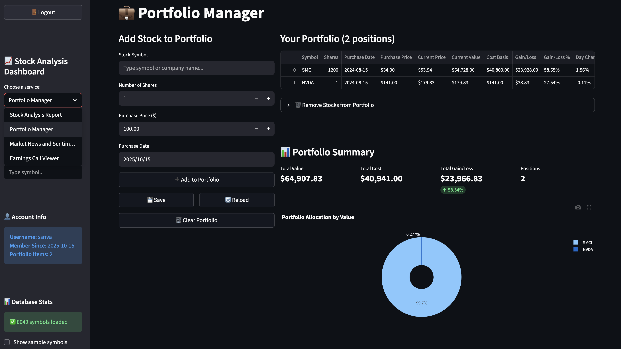

Slide 23
Iteration 3 – Intelligence & Alerts (Nov 4 – Nov 17)
Build Market News & Sentiment Service (API)
Develop Alert & Notification Service (event-driven triggers)
Enable low-latency data delivery for dashboards
Integrate fault tolerance, retry logic, and caching

Slide 24
Iteration 4 – Integration & Finalization (Nov 18 – Dec 1)
Deploy MVP and document APIs for next phase
Integrate all microservices end-to-end
Harden security and authentication flows
Conduct load testing and performance tuning

